Slide 1
Phishing Awareness Training
CodeAlpha Cyber Security Internship
Presented By: Ala Sailaja

Slide 2
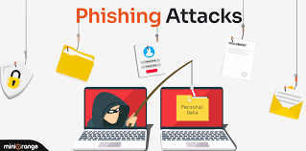
What is Phishing?
Phishing is a cyberattack used to steal sensitive information.
Attackers pretend to be trusted organizations.
Victims are tricked into revealing passwords, OTPs, and banking details.
Phishing attacks often arrive through email, SMS, or fake websites.

Slide 3
Types of Phishing
Email Phishing
Spear Phishing
Whaling
Smishing (SMS Phishing)
Vishing (Voice Phishing)

Slide 4
How Phishing Works
Attacker creates a fake message.
Victim receives email or SMS.
Victim clicks malicious link.
Fake website requests credentials.
Attacker steals information.

Slide 5
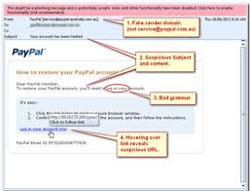
Signs of a Phishing Email
Unknown sender
Urgent messages
Grammar mistakes
Suspicious attachments
Unexpected login requests
Fake links

Slide 6
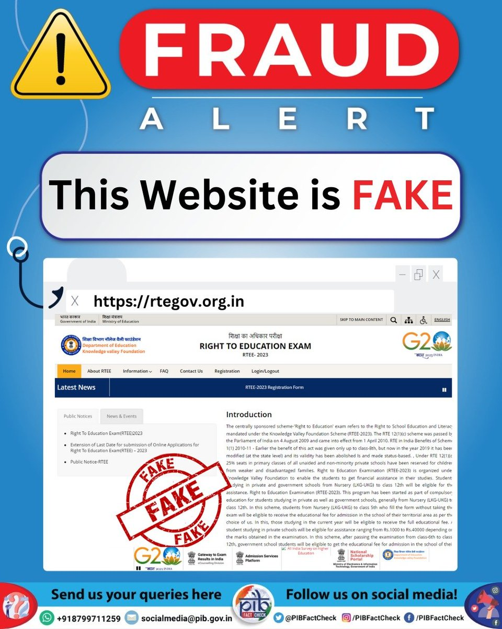
Fake Website Indicators
Misspelled URLs
No HTTPS
Poor website design
Pop-up login requests
Unusual payment requests
Example:
www.amazon-security-login.com

Slide 7
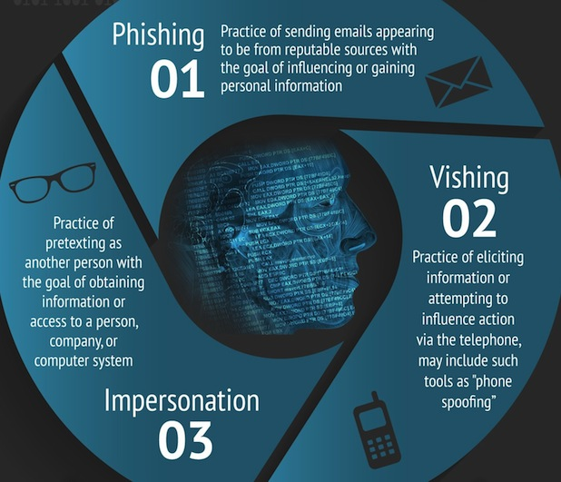
Social Engineering Techniques
Authority
Fear
Urgency
Curiosity
Trust Exploitation
Attackers manipulate human psychology to steal information.

Slide 8
Real-World Example
Bank Account Suspension Scam
User receives fake bank email.
Email asks for account verification.
Victim clicks link and enters credentials.
Attacker gains access to the account.

Slide 9
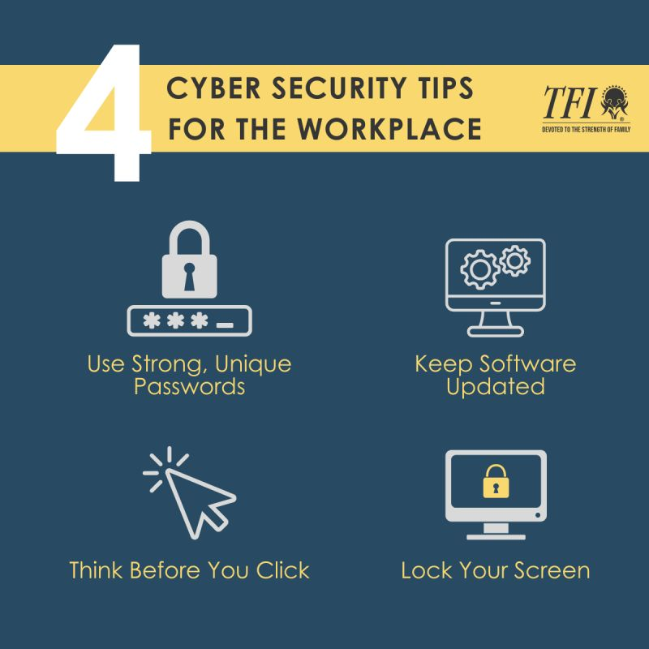
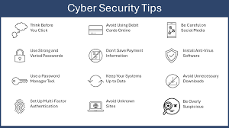
Prevention Tips
Verify sender identity.
Enable Multi-Factor Authentication (MFA).
Avoid clicking unknown links.
Use strong passwords.
Keep software updated.
Use antivirus protection.

Slide 10
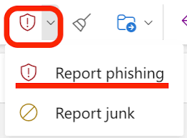
What To Do If You Suspect Phishing
Do not click links.
Do not download attachments.
Report the email.
Change passwords immediately.
Scan your device.
Inform the IT department.

Slide 11
Quiz
Question 1
What is phishing?
Question 2
Name two types of phishing.
Question 3
What does HTTPS indicate?
Question 4
Should you share OTPs with anyone?
Answer: No

Slide 12
Conclusion
Phishing remains one of the most common cyber threats.
Awareness helps prevent attacks.
Always verify before trusting online communications.
Stay alert and practice safe browsing habits.

Slide 13
References
OWASP
NIST Cybersecurity Framework
CISA Cybersecurity Resources
Microsoft Security Blog
Google Security Center

